Slide 1
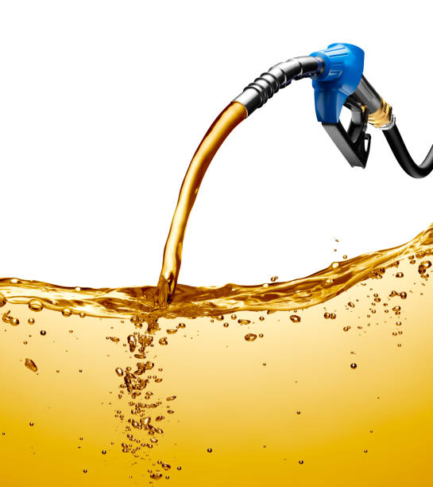
Petrol Price Forecasting
Vaibhav Joshi

Slide 2
Objective:
Development of a forecasting model to find forecasted price of petrol.
Benefits:
This model can be used to determine the petrol price in coming days based on present or historic datas.

Slide 3
Architecture
Data Preparation
Model development
Data Preprocessing
Exploratory Data Analysis
Feature Engineering
Model implementation
Model Evaluation
Model Training

Slide 4
Data validation and transformation
dAta type | Null values | Numerical columns | Categorical columns
Data type of columns is given in the schema file. It is validated when we insert the files into Database. | If any of the columns in a file have all the values as NULL or missing, we can fill it by some methods. | All the numerical features were standardized using Standard Scaler, preventing any data leakage. | Ordinal Encoding was used to treat categorical columns for the model in understandable way.
If data type is wrong, we can convert it using pandas library. | We can fill them by using mode of categorical columns or mean of numerical columns. | This process is done in pipeline for numerical features for the convenience of deployment. | This process is done in pipeline for categorical features for the convenience of deployment.

Slide 5
Data Ingestion
Excel File- The dataset was imported from Excel File into python.
Data Frame was created using pandas.

Slide 6
Model Training
1.The data in database is imported to Jupyter notebook by using pandas.
2. In data preprocessing step, data is checked if there missing data, duplicate values.

Slide 7
Model Selection:
SARIMA and ARIMA model were used to predict the future value.
Prediction
The model is made in such a way to maximize the accuracy and also other performance metrics
so that the predictions are as accurate as possible.

Slide 8
Q&A
What is the source of data?
The exxcel file is source of data.
What was the type of data?
The data is numerical and date form type.

Slide 9
What is the complete flow you followed in this project?
Refer to 3rd slide for the process flow.

Slide 10
What techniques were you using for data pre-processing?
Visualizing relation of independent variables with each other and output variables
Checking for null values.
Checking for duplicate values.
Cleaning data and imputing if null values are present.
Scaling the data

Slide 11
How training was done or what models were used?
First, we started with data cleaning, EDA and feature engineering. Data type of columns were corrected by using pandas attributes.
Then Checked with ARIMA and SARIMA models.

